Slide 1
“I-CHING”, THE DOCTRINE OF GENO-LOGIC CODE AND GENETIC MUSIC S.V. Petoukhov, E.S. Petukhova Russian Academy of Sciences, Moscow http://petoukhov.com/

Slide 2
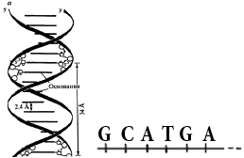
Genetic information is written in DNA by means of sequences of 4 letters: adenine A, cytosine C, guanine G, thymine T. (The RNA-alphabet also contains 4 letters: adenine A, cytosine C, guanine G, thymine T). Two questions arise: 1) why the genetic alphabet is constructed by Nature on the base of 4 letters? (why not, for example, 30 or 50 letters?); 2) why the alphabet is constructed on the base of these simple molecules though millions other molecules exist?

Slide 3
Likely answer is related to the fact that this set of 4 molecules possesses symmetrical properties since it has 3 pairs of binary-oppositional traits: 1) two letters are purines (A and G), and other two are pyrimidines (C and T) . From the standpoint of these traits one can denote A=G=0, C=T=1. From the standpoint of these traits any DNA-sequence is represented by a corresponding binary sequence. For example, GCATGAAGT.… is 01010001… 2) two complementary letters (A and T) have two hydrogen bonds and other complementary letters (C and G) have three bonds. From the standpoint of these traits A=T=0, C=G=1, and the same DNA-sequence GCATGAAGT.… is 110010010… 3) two letters are keto (G and T) and two other letters are amino (A and C). From the standpoint of these traits A=C=0, G=T=1, and the sequence GCATGAAGT.… is 100110011…

Slide 4
The DNA-sequence GCATGAAGT.… is represented by binary sequences: 1) 010100001… (if A=G=0, C=T=1) 2) 110010010… (if A=T=0, C=G=1) 3) 100110011… (if A=C=0, G=T=0) So, any DNA-sequence is a bunch of 3 parallel messages on 3 different binary languages. It is true for all biological bodies, which are identical from the point of view of the molecular-genetic foundations (DNA, etc.)

Slide 5
Эти три бинарных языка взаимно связаны логической операцией сложения по модулю 2, совершаемой по правилам: 0+0=0, 1+1=0, 0+1=1, 1+0=1. Для названной секвенции GCATGAAGT имеем: So, any DNA-sequence is a bunch of 3 parallel messages on 3 different binary languages. It is true for all biological bodies, which are identical from the point of view of the molecular-genetic foundations (DNA, etc.

Slide 6
Science has led to a new understanding of life itself: «Life is a partnership between genes and mathematics» [Stewart I. Life's other secret: The new mathematics of the living world. 1999, N.-Y.]. But what mathematics is a partner of genes? It turned out that math of binary numbers and matrices is a natural partner of the genetic coding system that has a property of noise-immunity coding at transmission of information along a chain of generations.

Slide 7
The appropriate “matrix mathematics” exists in technologies of digital communication, where we have similar problems of noise-immunity coding of information, for example, in the case of transmission of high-quality photos of the Martian surface to Earth in conditions of strong distortion and attenuation of electromagnetic signals passing through millions of kilometers of interferences. These technologies use the so-called Kronecker's family of Hadamard matrices consisting of 4, 16, 64, ... members:

Slide 8
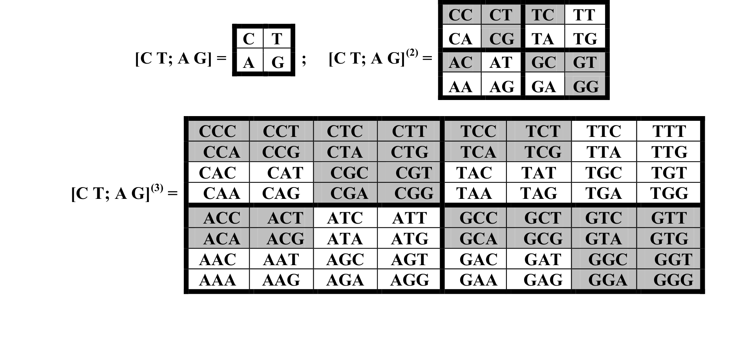
The same quantities of members characterize alphabets in DNA: 4 monoplets (adenine A, cytosine C, guanine G, thymine T), 16 doublets (AA, AC, ...), 64 triplets (AAA ACT, ...), etc. All these alphabets are interrelated, and they are represented by corresponding matrices of the Kronecker family:

Slide 9
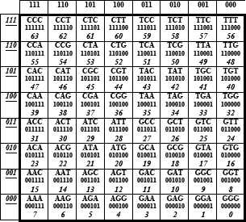
These genetic matrices have deep analogies with the Yin-Yang system of the ancient Chinese book “I-Ching” written several thousands years ago. The famous table of 64 hexagrams in Fu-Xi’s order exists there, which has many deep analogies with the genetic matrix of 64 triplets. The ancient Chinese claimed that this table is the universal archetype of nature. They knew nothing about the genetic code, but the genetic code is constructed in accordance with the ”I-Ching”.

Slide 10
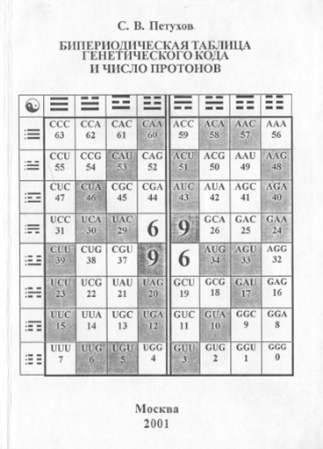
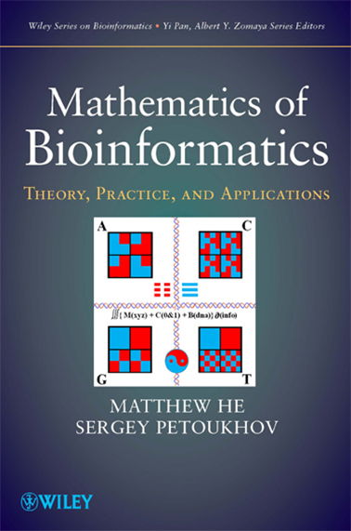
Matrix mathematics of the genetic coding system ("matrix genetics") and deep analogies of this system with the “I-Ching” are described in my books, published in Russia and the United States. These books and other our publications are posted for free reading on my site http://petoukhov.com/ .

Slide 11
Today's lecture contains only two brief fragments of our works in the field of matrix genetics: 1) the doctrine of the geno-logical code and the genetic logical holography; 2) the theme of genetic music and musical therapy.

Slide 12
ABOUT THE GENO-LOGIC CODE The known genetic code of sequences of amino acids in proteins is not sufficient to explain many inherited phenomena in living bodies. We believe that another kind of the genetic code exists in parallel with it. We are developing a relevant mathematical doctrine about the second code.

Slide 13
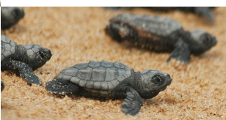
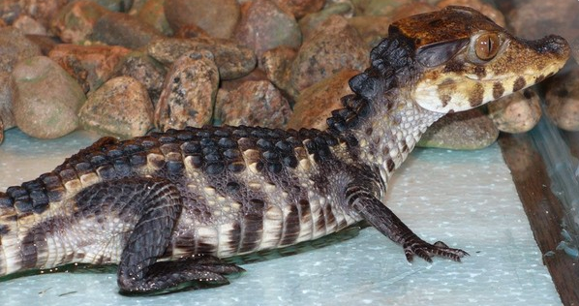
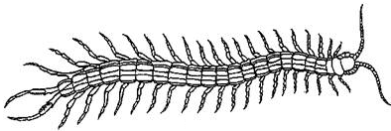
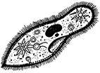
As known, newborn turtles and crocodiles, when they hatched from eggs, crawl with quite coordinated movements to water without any training from anybody. Celled organisms, which have no nervous systems and muscles, move themselves by means of perfectly coordinated motions of cilia on their surfaces (the genetically inherited “dances of cilia”): The cilia “dance” in the celled organism (Opalina ranarum}

Slide 14
It is obvious that the known genetic code of sequences of amino acids in proteins can’t explain these inherited algorithmic motions, in which a great quantity of muscle units, nerve cells, etc. are working in a coordinated way like parts of a computer. Computers are based on networks of two-positional switches (triggers), each of which can be in one of two states: “yes” or “no”. But in physiology, the "trigger-type” law “all-or-none” for excitable tissues is known: a nerve cell or a muscle fiber give only their answers "yes" or "no" under action of different stimulus by analogy with Boolean variables. For stimulus of sub-threshold values, a nerve or a muscle fiber give no response; for supra-threshold values of stimulus they give responses of their maximal amplitude.

Slide 15
R. Penrose [“Shadows of the Mind”, 1996] - in his thoughts about biological quantum computers - appeals to the known fact that tubulin proteins exist in two different configurations, and they can switch between these configurations like triggers to provide bio-computer functions.

Slide 16
Taking these known facts into account, we propose to consider a living organism as a genetically inherited huge network of triggers of different types and different biological levels, including trigger subnets of tubulin proteins, muscle fibers, neurons, etc. From this perspective, biological evolution can be represented as a process of self-organization and self-development of systems of biological trigger networks. Correspondingly, the Darwinian principle of natural selection is understood, first of all, as natural selection of biological networks of triggers together with appropriate systems of Boolean functions for coordinated work of these networks. From the standpoint of this approach, when a reflexologist influences on an acupuncture point, he influences on a whole biological system of Boolean functions. This point influence can be compared with a clicking on one key of computer that changes the program of work of the entire computer by automatic changing states of its great number of triggers and their Boolean-algebraic relations.

Slide 17
We have shown in our studies that the molecular-genetic system is closely linked to dyadic groups of binary numbers, Boolean algebra, spectral logic of systems of Boolean functions and Walsh functions. It is this mathematics in digital devices of artificial intelligence and noise-immunity coding information (see our publications on the websitehttp://petoukhov.com/ )

Slide 18
THE LOGICAL HOLOGRAPHY AND GENETICS Living organisms possess quasi-holographic properties, which were described by many authors. For example, embryologist H.Driesch has shown in 1921 in experiments with sea urchin eggs that failly normal larvae can be obtained from a single embrionic cell containing no more than 1⁄2 or even 1⁄4 of the entire egg’s material. Similar properties exist in holograms, where a part of a hologram is enough for restoring the whole holographic image of a material object. Quasi-holographic properties of the brain (including associative memory, processing visual information, etc.) were also repeatedly described [K.Pribram «Languages of the Brain», 1971; etc].

Slide 19
Physical holography is based on two coherent physical waves. But physical waves can be modeled digitally in computers (“digital holography”). The Japanese article «Holography by Walsh waves» [Morita, Sakurai, 1973] for electric curcuits with logical operations in them was the pioneer work, which was followed by other authors. The work was devoted to Walsh waves (or Walsh functions) propagated through electronic circuits.

Slide 20
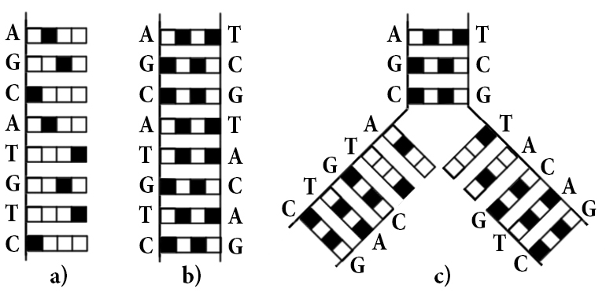
Due to our discovery of a connection of the genetic system with Walsh functions, we are developing the mathematical theory of the genetic logical holography. On the base of this theory we have created a several initial models of genetic phenomena, for example: 1) the model of different repetitions in nucleotide sequences: 2) the model of the zipper-like reproduction of DNA:

Slide 21
In addition, Walsh functions and dyadic groups are the base of so called “spectral logic of systems of Boolean functions”, which allows creating digital devices with rich properties of artificial intellect: a detection and correction of errors; an adaptation to the external environment; a training in a course of work; interactions with other digital devices, etc. We develop such new digital devices of “genetic logic” in my laboratory. This spectral logic is a part of our doctrine of the geno-logical code, which exists in parallel with the known genetic code of amino acids.

Slide 22
Different species vary in their body materials (eg, the eyes can be very different in their substrates). But all these materials are subordinated to algebraic-logical coding. In living matter reigns informatics of geno-logical coding [Petoukhov, 2016].

Slide 23
E.Schrodinger (1944) noted: “from all we have learnt about the structure of living matter, we must be prepared to find it working in a manner that cannot be reduced to the ordinary laws of physics… because the construction is different from an anything we have yet tested in the physical laboratory». For comparison, biological enzymes are millions of times more effective than catalysts in laboratory. What makes the enzyme for 1 second, a conventional catalyst can make only for 200,000 years. We believe that such inherited efficiency of enzymes in biological bodies is defined not only by laws of physics, but also by algebra-logical algorithms of the geno-logic coding, and therefore - in accordance with Schrodinger - this efficiency cannot be reduced to the ordinary laws of physics. It seems that alloplant processes are also managed by the system of geno-logic coding.

Slide 24
Jellyfishes consist of 99% water. Their structured water is also subordinated to the geno-logic coding. We hypothesize that structured water is not only a set of molecules but it is the carrier of logical functions and logical operations that are involved in the properties of water (homeopathic, etc.) [Petoukhov, 2016]. It is in contrast to traditional consideration of water - in academia sciences – as only a set of molecules without the provisions on participation in it laws of Boolean algebras, on which computer science is built ("water as an information entity"). In the lecture of Prof. E. Muldashev I was pleased to learn on his similar thoughts about a "thinking water."

Slide 25
George Boole created his mathematics of logic to desribe the laws of thoughts: his book was titled «An Investigation of the Laws of Thoughts» (1854 year). Our doctrine of the geno-logic code shows evidences that our genetically encoded body is created on the basis of the same laws of logic, on which our thoughts are constructed (the unity of the laws of thought and body). It gives a new material for a discussion about old problem: what is primary - thoughts or matter?

Slide 26
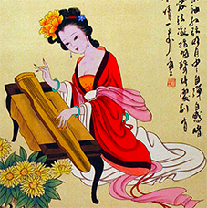
RATIOS OF MUSICAL HARMONY IN SEQUENCES OF DNA; GENETIC MUSIC

Slide 27
The ancient Chinese declared the fundamental importance of musical harmony for organizing the universe. They used the musical system known in Europe under the name Pythagoras musical scale (or quint scale). This Chinese system was borrowed by Pythagoras [Needham, 1962, v.4]. The notion "quint" means the ratio 3/2. Numbers 3 and 2 are the bases of the Ancient Chinese arithmetic.

Slide 28
Ancient Greeks attached an extraordinary significance to search of the quint 3:2 in natural systems because of their thoughts about musical harmony in the organization of the world. For example, Archimede considered as the best result of his life a detection of the quint 3:2 between volumes (and surfaces) of a cylinder and a sphere entered in it. Just these geometrical figures with the quint ratio were pictured on his gravestone according to Archimedes testament.
Vcyl : Vsph = Scyl : Ssph = 3:2

Slide 29
Mathematical scale in music is a set of ratios between frequencies of adjacent musical notes. The ancient Chinese scale (and the Pythagoras scale) is based on quint ratio (3/2) and have a two-interval character (Yin-Yang character) in contrast to the equal temperament scale. After Ancient China, Pythagoreans considered numbers 2 and 3 as the female and male numbers, which can give birth to new musical tones in their interconnection.

Slide 30
This Table demonstrates a known fact of application of the quint 3/2 to construct a symmetrical sequence of 7 musical notes of the Pythagoras scale; a frequency ratio between any adjacent notes of this sequence is equal to the quint 3/2. So, the Pythagorean scale is based on the geometric progression with the factor 3/2.

Slide 31
In Ancient China, music on the base of quint scale was intensively used in musical therapy. We have paid attention that numbers 2 and 3 and ratios of quint musical harmony are implemented in parameters of DNA.

Slide 32
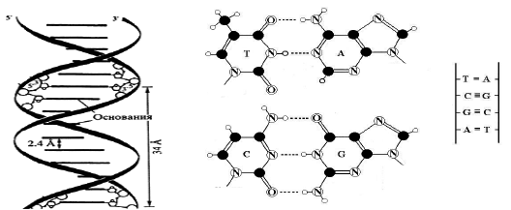
.
In DNA, letters A-T and C-G form complementary pairs with 2 and 3 hydrogen bonds in them, respectively. Correspondingly we have a numeric representation of the code letters: A = T = 2, C = G = 3. DNA is a chain of numbers 3 and 2 of hydrogen bonds.

Slide 33
The genetic code encodes sequences of 20 amino acids in proteins by means of 64 triplets - (three-letter words) that represent all possible combinations of these four letters (ATC, TTA, ...). Since A = T = 2, C = G = 3, each triplet has a numeric representation as a product of number of hydrogen bonds of its constituent letters. For example, the triplet ACT is represented by number 2*3*2 = 12.
Each of 64 triplets is represented by one of numbers of hydrogen bonds 2³=8, 2²*3=12, 2*3²=18, 3³=27, the pairwise relations between which are equal to the quint 3/2 in varying integer degrees, for example, 27/8 = (3/2)³, 18/8 = (3/2)², etc. Accordingly, each DNA molecule as a chain of hydrogen bonds is characterized by its own sequence of the quint 3/2 in different integer degrees.

Slide 34
If in DNA we consider pairs of adjacent triplets, then DNA molecule appears as a quint sequence of 7 kinds of numbers of hydrogen bonds: 2⁶=64, 2⁵*3=96, 2⁴*3²=144, 2³*3³=216, 2²*3⁴=324, 2*3⁵=486, 3⁶=729. Pairwise ratios in this series of numbers are equal to the quint 3/2 in the same degrees as in the Pythagoras 7-stage scale: If, for example, the frequency of 87 Hz of the note "F" is compared to the number 64, then all the rest numbers of this set will correspond to the other notes of the Pythagoras scale. Then any sequence of triplets (eg, insulin gene GGC-ATC-GTT-GAA-CAG-TGT- ...) can be associated uniquely with a sequence of notes of the Pythagoras scale (“genetic music in the Pythagoras scale”).

Slide 35
The quint ratios are realized in DNA not only for the hydrogen bonds of complementary bases, but also for several other parameters, such as quantities of atoms in the rings of purines and pyrimidines (numbers 9 and 6 with the ratio 3/2), or the amount of protons in the rings of complementary nitrogenous bases (numbers 60 and 40 with the ratio 3/2), and others. Chains of these parameters in DNA form their own sequences of quint, which correspond to sequences of notes of quint scales. In other words, Nature created DNA as a plexus of various sequences of quint ("quint polyphony of DNA").

Slide 36
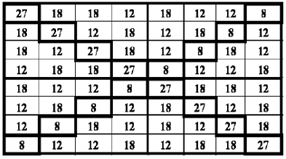
THE FAMILY OF QUINT GENETIC MATRICES In the Kronecker family of matrices of genetic alphabets one can replace each of their components by number defined by its quantities of hydrogen bonds (based on A = T = 2, C = G = 3). In this case the family of numeric matrices arise, which are called "quint matrices" since the ratio 3/2 characterizes many parts of them.

Slide 37
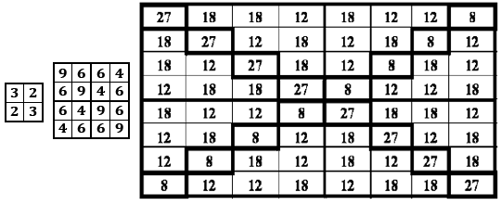
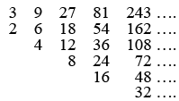
In particular, the sets of numbers in each of quint matrices form a quint sequence, the totality of which is represented by the numerical triangle: But this genetic triangle was published 2000 (!) years ago by Nichomachus of Gerasa in his famous book “Introduction into arithmetic”.

Slide 38
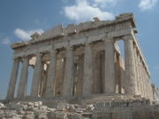
3 9 27 81 243 …. 2 6 18 54 162 …. 4 12 36 108 …. 8 24 72 …. 16 48 …. 32 …. This “genetic” triangle was famous for centuries as the bases of the Pythagorean theory of musical harmony and aesthetics. In accordance with this triangle, the Parthenon and other great architectural objects were created because architecture was interpreted as the non-movement music, and the music was interpreted as the dynamic architecture.

Slide 39
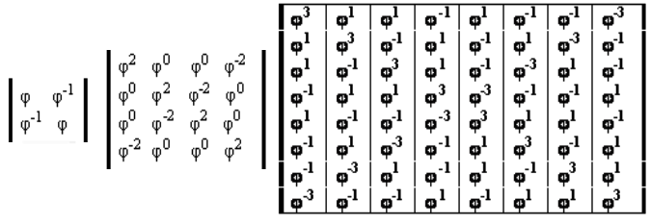
QUINT GENETIC MATRICES AND THE GOLDEN SECTION The quint matrices have a hidden relation with the famous golden section φ = (1+5^{0.5})/2 = 1,618… If we take the square root from any previous quint matrix, the result is a matrix, all elements of which are precisely equal to the golden section φ in different integer powers (quint matrices have a "backing" in the form of "golden" matrices). Themes of “the quint 3/2” and “the golden section φ” are interrelated.

Slide 40
The golden section is the mathematical symbol of a self-reproduction for many centuries (Leonardo da Vinci, J.Kepler, etc). It is well known that the golden section is shown by many authors in different physiological systems: cardio-vascular system, respiratory system, electric activities of brain, etc.

Slide 41
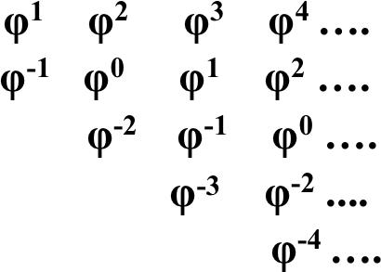
The Kronecker family of golden matrices defines a new - "golden" - triangle of their elements (similar to the quint triangle of Nichomachus): The ratio between adjacent numbers is equal to φ².

Slide 42
Using the known algorithm of creation of the Pythagoras musical scale for the case geometric progression of two types - with the coefficient 3/2 and with the coefficient φ², we have got the hierarchy of quint scales and the hierarchy of Fibonacci-stage scales (where quantity of stages coincides with Fibonacci numbers).

Slide 43
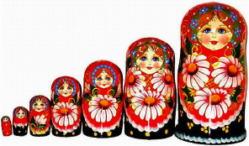
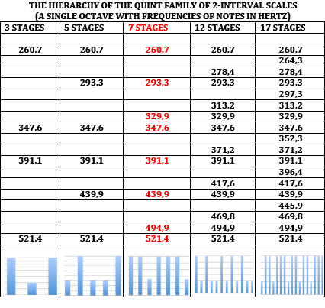
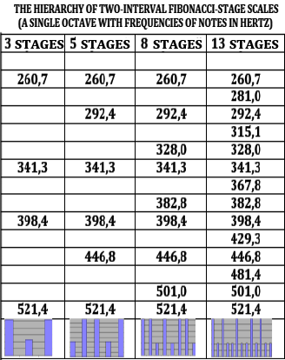

Slide 44
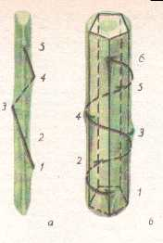
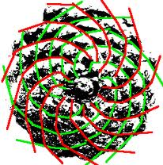
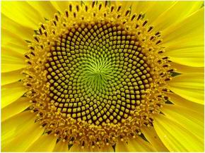
The golden section φ is closely associated with the set of Fibonacci numbers, which are implemented in
inherited configuration of many living organisms in accordance with laws of phyllotaxis (hundreds of publications are devoted to laws of phyllotaxis):
F_{n} = F_{n-2}+F_{n-1}: 0, 1, 1, 2, 3, 5, 8, 13, 21, 34, 55, 89,…
The ratio of two adjacent Fibonacci numbers F_{n+1}/F_{n} tends to the golden section with increasing n.

Slide 45
The ratio φ² exists in regular 5-stars (pentagrams) as the ratio between sides of pentagrams entered in each other. The pentagram was an ancient symbol of health in the Pythagorean school.

Slide 46
Families of Fibonacci-stage scales initially aroused as mathematical scales in the course of analysis of molecular-genetic system. But because of their obvious connection with musical quint scales, they have attracted attention of musicians of the Moscow Conservatory, which began to study them from the standpoint of musical harmony. They discovered rich harmonic characteristics of these scales and prospects of their application for the work of composers and musical therapy. G.Leibniz declared that music is arithmetic of soul, which computes without being aware of it.

Slide 47
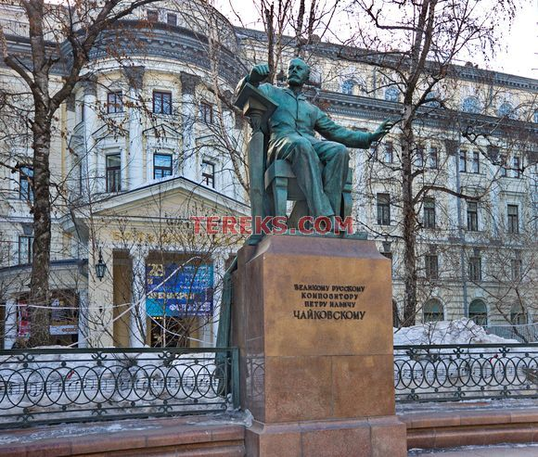
The Moscow State Conservatory by name P.I.Tchaikovsky has created in 2012 its official "Center for Interdisciplinary Studies of Musical Creativity”, one of main tasks of which is a development of music on the genetic musical scales as a new direction of musical culture.

Slide 48
The first concert of such genetic music has been performed by the Moscow Conservatory in Vienna, Austria on 4 June 2015. Video of its fragments with some explanations is shown at http://youtu.be/gagKLDuO9z8 . The 2nd and 3rd concerts of genetic music have been performed by the Moscow Conservatory in Vienna, Austria on 19 and 20 July 2016. Video of its fragments is shown at https://youtu.be/kxxH3-793WQ .

Slide 49
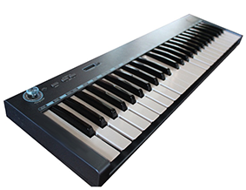
Among other projects, members of our Center are creating a new class of musical instruments on the base of genetic Fibonacci-stage scales (http://pentagramon.com/en/).

Slide 50
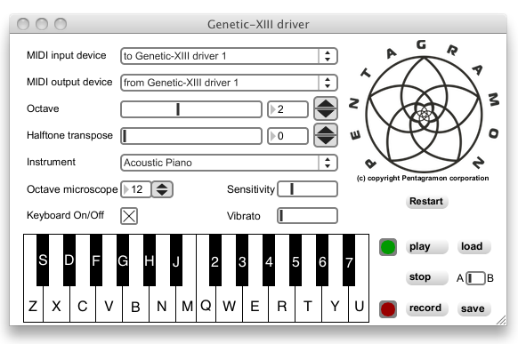
In this Center a special computer program was created providing sounding of genetic music when execution on an ordinary synthesizer, which is connected with computer. The driver interface:

Slide 51
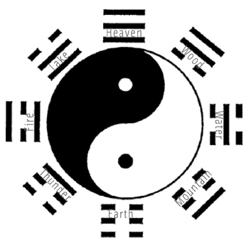
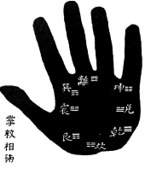
Traditional Oriental medicine, music and many aspects of life in Oriental countries were based on the Ancient Chinese book “I-Ching”. Confucius said: “If it would be possible to extend my years, I would have given fifty of them for study of "I-Ching”. Niels Bohr has chosen the symbol Yin-Yang as his personal emblem. .

Slide 52
“I-Ching” and genetic matrices The Ancient Chinese “I-Ching” (“The Book of Changes”) deals with Yin-Yang symbols including the four basic digrams: Old Yang ( ), Old Yin ( ), Young Yang ( ) and Young Yin ( ). The famous table of 64 hexagrams in Fu-Xi’s order exists in this symbolic system:

Slide 53
Examples of analogies between genetic system and “I-Ching”:
Molecular-genetic system | I-Ching
4 nitrogenous bases A, C, G, T have a basic meaning: | 4 digrams have a basic meaning: Old Yang ( ), Old Yin ( ), Young Yang ( ) and Young Yin ( ).
The third tensor power of the genetic matrix leads to the matrix of 64 triplets. | The third tensor power of the matrix ⁽³⁾ leads to the table of 64 hexagrams of Fu-Xi’s order.
2 and 3 hydrogen bonds connect complementary DNA-letters A-T and C-G. | Numbers 2 and 3 were fundamentals of Ancient Chinese arithmetic.

Slide 54
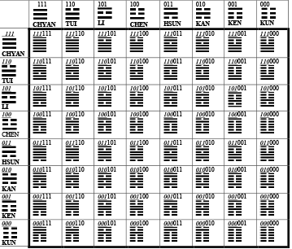
Each of 64 hexagrams consists of trigrams, which give numerations of its row and its column and which are identical to 3-digit binary numbers. The same construction with binary numbers exists in the DNA-alphabet of 64 triplets G.Leibniz, who considered himself a creator of binary numbers, was amazed to learn that the Chinese have known them for thousands of years before him. .

Slide 55
According to the creator of analytical psychology Carl Jung, trigrams and hexagrams of “I-Ching” “fix a universal set of archetypes (innate psychic structures)”. С.Jung argued that an active communication with the archetypes of consciousness is very healthful. In his clinic Jung cured people, giving them intensive communication in various forms with the archetypes of consciousness, first of all, from the book “I-Ching”, in which he was an expert (the amplification method of Jung). I hope that in the result of my lecture, where many archetypes from “I-Ching” were discussed in active forms, all the people in this room have become healthier.

Slide 56
Families of genetic musical scales – quint scales and Fibonacci-stage scales – are also deeply connected with I-Ching. I have just returned from China, where, at the invitation of one of the universities, gave lectures on the matrix genetics, including genetic music in connection with "I-Ching”. A program of Russian-Chinese cooperation in this field was developed.

Slide 58
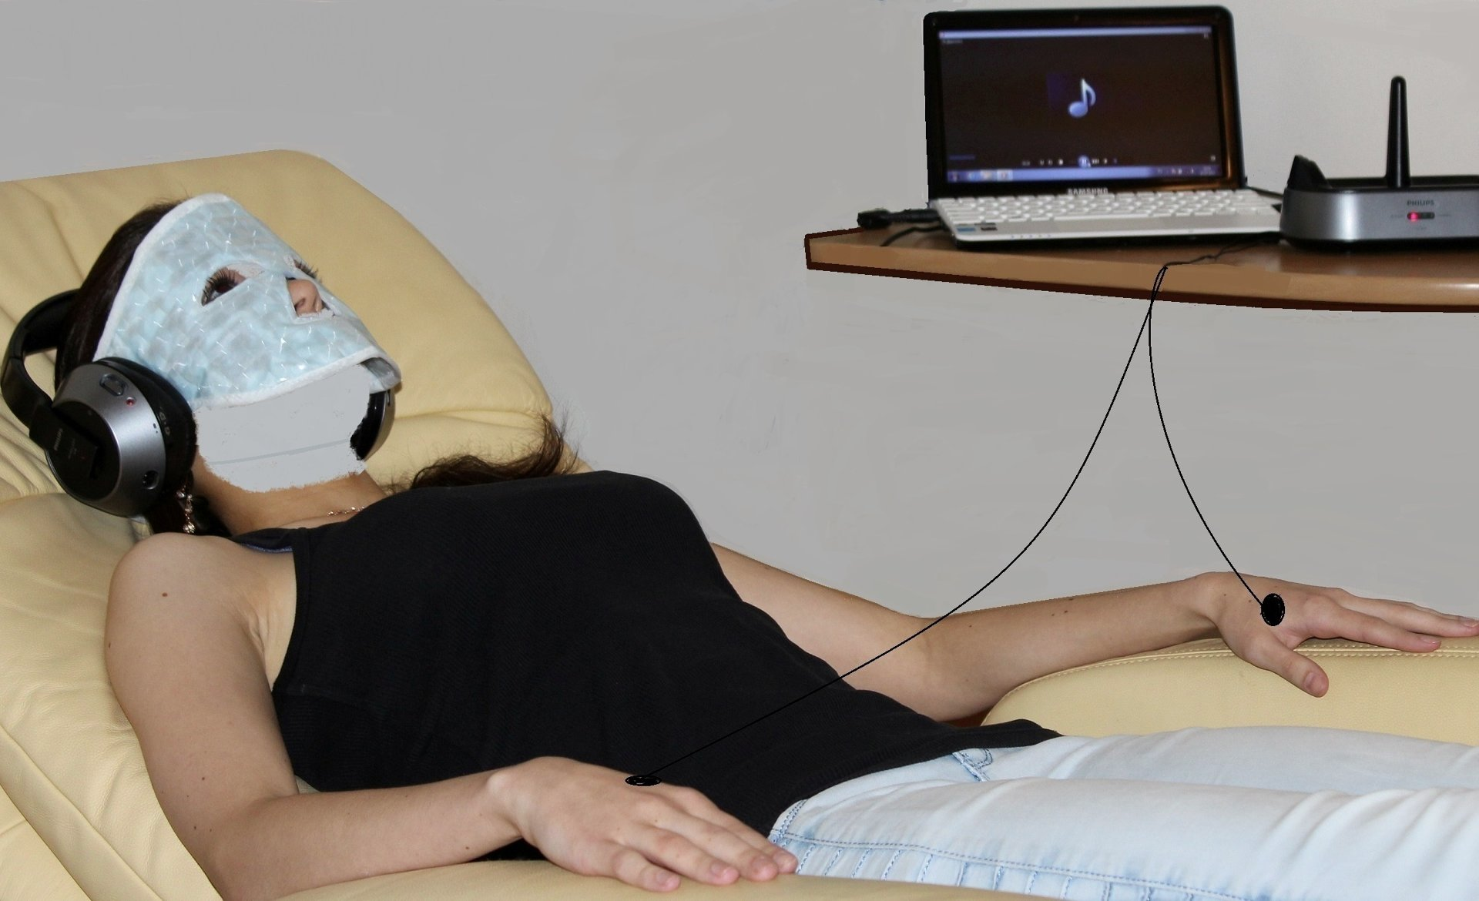
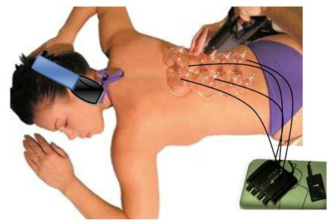
In applications of genetic music to musical therapy, our Centre of the Moscow Conservatory collaborates with a partner: "Center of music therapy and recovery technologies” (www.doctor-art.ru, доктор-мьюзик.рф). His head is Ph.D. Prof. Sergey Shushardzhan, a specialist in the field of acupuncture. At the same time he has a higher musical education (he was the soloist of the Bolshoi Theatre in Moscow). He is the president of the European Academy of Musical Therapy. His Center possesses a state certificate to conduct musical therapy, and it also possesses unique equipment and methodological framework. In particular, acoustic-musical influence on acupuncture points is performed.

Slide 59
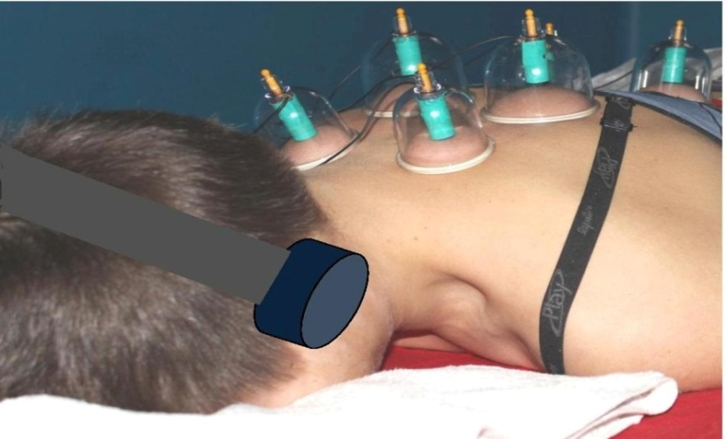
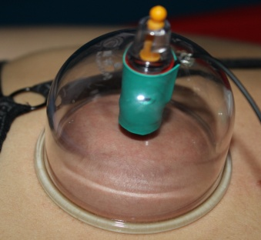
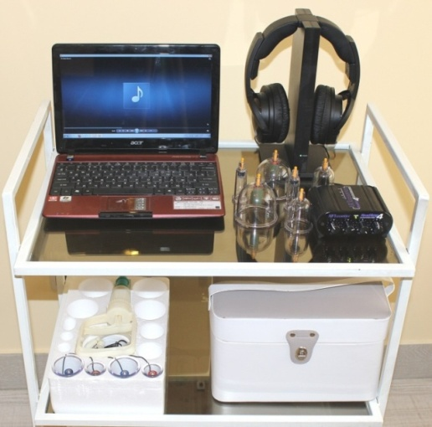
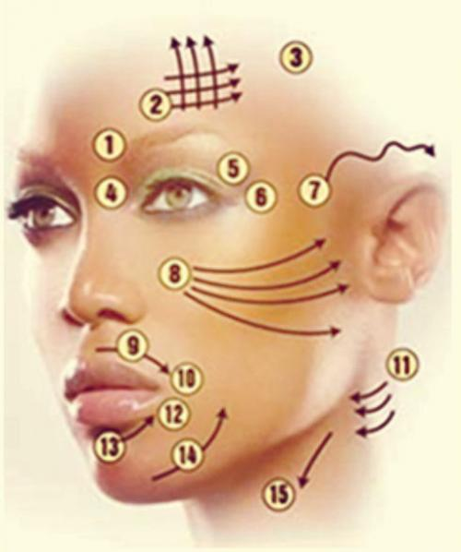
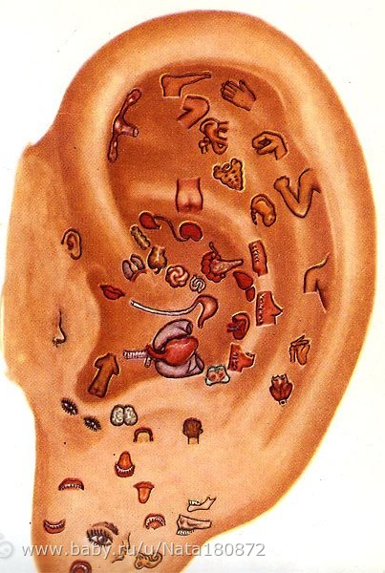
MUSICAL THERAPY www.doctor-art.ru, доктор-мьюзик.рф

Slide 60
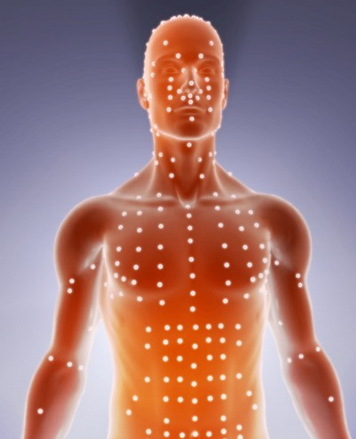
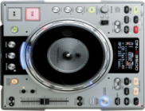
III Музыка и точки акупунктуры
Установлено, что контактное воздействие непосредственно на точки акупунктуры значимо меняет электропроводность кожи.
Выявлено, например, что струнные:
скрипка, гитара и пр. вызывают
нормализующие изменения
в точках меридиана сердца
(по методу Dr. Voll).
(С.В.Шушарджан, 1998, 2005).

Slide 61
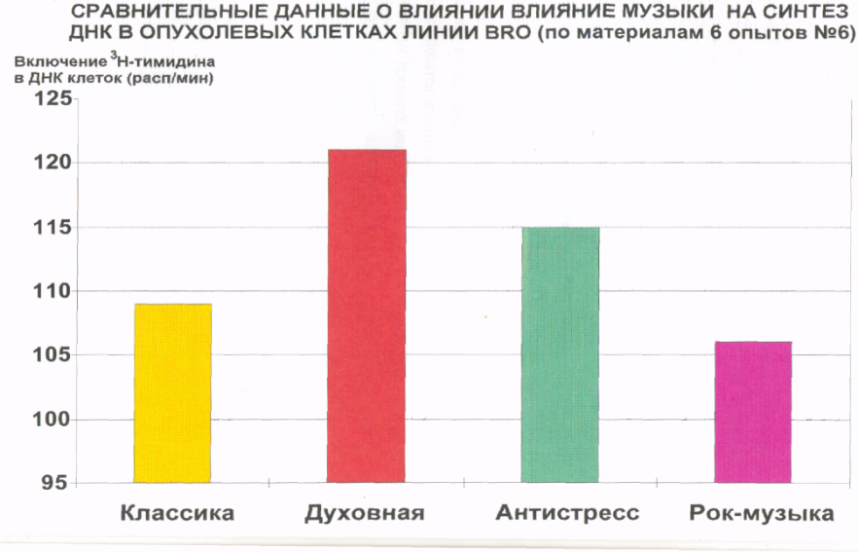
Исследования : музыка и опухолевые клетки in Vitro
В данной серии экспериментов с применением радиоизотопного метода исследовалась способность различных видов музыки влиять на активность синтеза ДНК культуры опухолевых клеток (меланома линии BRО). Установлено, что после музыкально-акустических воздействий достоверно менялась интенсивность поглощения радиоактивного ³Н-ТИМИДИНА, которая в условиях проводимого эксперимента зависела от характера акустического воздействия.

Slide 62
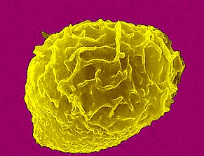
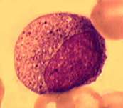
Исследования: влияние музыки на кровь in Vitro
WBC - общее число лейкоцитов возросло в 4,7 раза
число нейтрофилов увеличилось в 4,7 раза
число незрелых гранулоцитов возросло в 18,3 раза!
Появление значительного числа незрелых клеток говорит об участии в процессе стволовых гемопоэтических клеток.

Slide 63
THANK YOU FOR YOUR ATTENTION ! “I-CHING”, THE DOCTRINE OF GENO-LOGIC CODE AND GENETIC MUSIC S.V. Petoukhov, E.S. Petukhova Russian Academy of Sciences, Moscow http://petoukhov.com/

